Slide 1
Design and Evaluation of a Framework for Annotating Coloured Petri Net Models with Code Generation Pragmatics

Slide 2
Overview
Intro
MDE
Thesis motivation, aim and method
Case: WebSocket
Protocol
CPN Model
State Space
Prototype: Pragma/CPN
Demonstration
Evaluation

Slide 3
Model Driven Software Engineering
(MDSE)
Notes:
Is a software development methodology that puts models in the center of the process.
serve both as documentation and as a basis for implementation

Slide 4
Model Driven Software Engineering
Benefits
Abstraction
Platform independence
Reusability
Analysis
Key Concepts
Modeling and meta-modeling
Model Transformation
Especially code generation
Notes:
Analysis: correctness, completeness, scalability, finding race conditions

Slide 5
Model Driven Software Engineering
Modeling in Solution Domain
Vs
Modeling in Problem Domain
↓
Domain Specific Modeling Language (DSML)
Notes:
Before describing metamodeling, explain the reason for it.
KW: Using concepts in target domain
Creating a DSML is the largest hurdle, and can be costly
Need to create both the language and the tools to support it
Allows for reuse in target domain

Slide 6
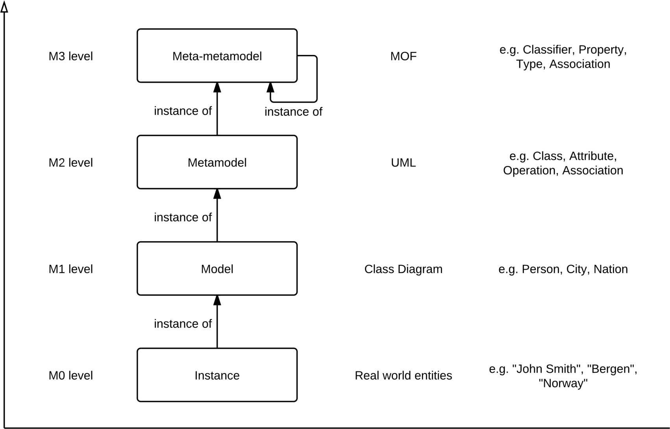
Meta Object Framework
Notes:
Created by Object Management Group (OMG) to provide the basis for metamodel definition in OMG’s family of modelling languages, particularly UML
Example of DSML in solution domain.

Slide 7
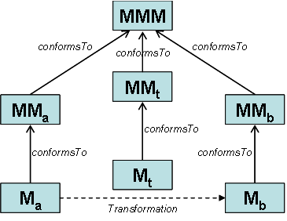
Model Transformations
Source:
http://help.eclipse.org/indigo/index.jsp?topic=%2Forg.eclipse.m2m.atl.doc%2Fguide%2Fconcepts%2FModel-Transformation.html

Slide 8
Background
Kent Inge Fagerland Simonsen: On the use of pragmatics for model-based development of protocol software. PNSE’11
Defining a DSML for protocol software
Coloured Petri Net (CPN) model annotated with code generation pragmatics
Platform model to describe implementation details for particular platform
Configuration model for particular protocol model
Notes:
Lot of research to develop DSML for different problem domains.
PNSE = Petri Nets and Software Engineering. International Workshop
CPN is a type of directed graph useful to model processes, especially with
an asynchronous and/or concurrent nature
Good methods for analysis, as I’ll show later

Slide 9
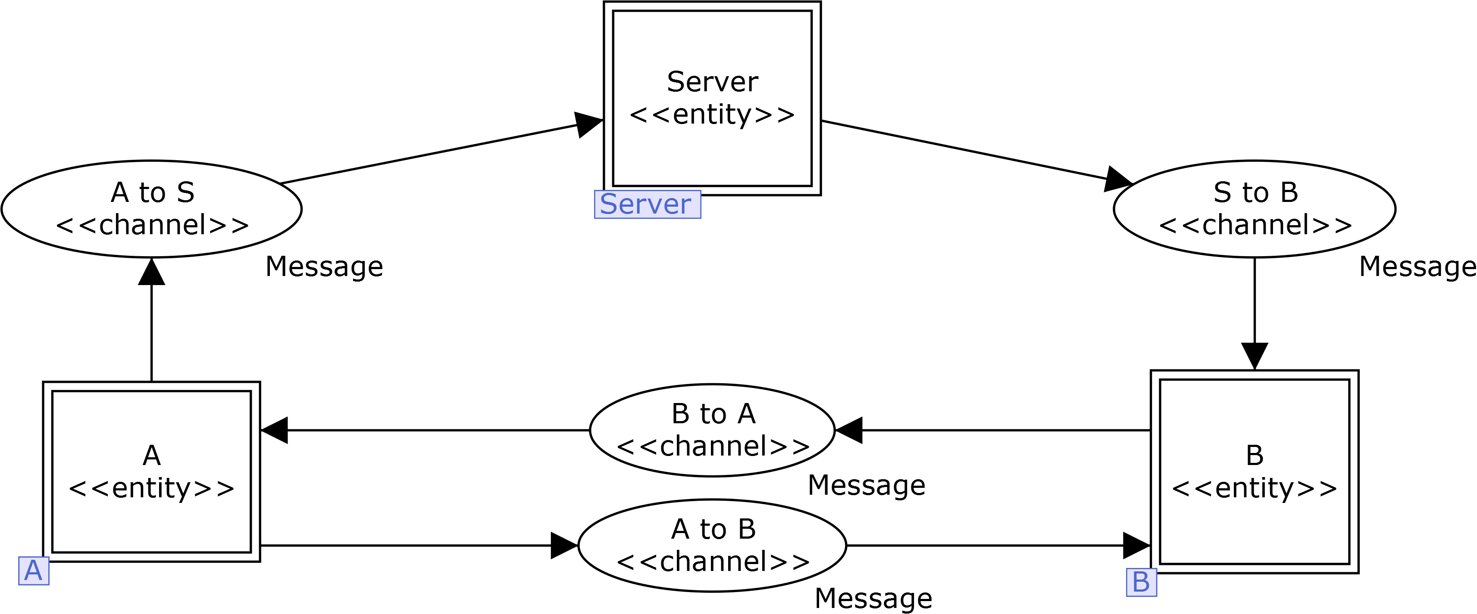
Kao-Chow authentication protocol
Notes:
Simonsen used KC as example
Used CPN Tools to annotate the model. Tedious, required lots of workarounds
Need for a dedicated tool for this task

Slide 10
Thesis Aim
Support annotation of CPN models with code generation pragmatics in a flexible and model-centric manner
Notes:
Based on Simonsens work, blablabla
By flexible we mean extensible,

Slide 11
Research Method
Create a prototype application framework
Evaluate it by annotating a selected set of CPN models of communication protocols

Slide 12
Prototype Requirements
Importing CPN Tools models.
Annotate model with pragmatics.
Provide only pragmatics that are applicable to the selected model element.
Loading sets of domain-specific pragmatics
reduce cluttering and potentially avoid performance reductions
Define set(s) of model-specific pragmatics

Slide 13
Pragmatics Categories
General pragmatics
protocol entities, communication channels, external method calls, API entry points
Domain specific pragmatics
apply to all (or many) protocols within a particular domain
Security protocols: encryption, decryption, nonce generation.
Model specific pragmatics
apply only to the specific model instances in which they are defined
label concepts unique to that model.
Notes:
for operations like establishing a connection, and sending or receiving data.

Slide 14
Case Study: WebSocket Protocol

Slide 15
WebSocket Protocol
Enables two-way communication between a client running untrusted code in a controlled environment to a remote host that has opted-in to communications from that code.
Goal: More efficient and simpler two-way communication for web apps
Origin-based security model
Notes:
o The server is forced to use a number of different underlying TCP connections for each client: one for sending information to the client and a new one for each incoming message.
o The wire protocol has a high overhead, with each client-to-server message having an HTTP header.
o The client-side script is forced to maintain a mapping from the outgoing connections to the incoming connection to track replies.

Slide 16
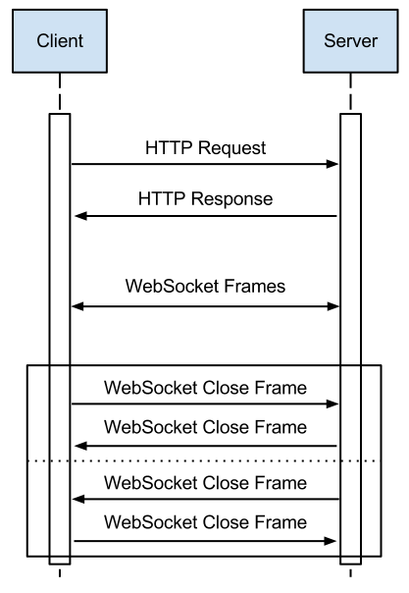
Sequence Diagram WebSocket Protocol

Slide 17
WebSocket Protocol
Client Handshake
Server Handshake
GET /chat HTTP/1.1
Host: server.example.com
Upgrade: websocket
Connection: Upgrade
Sec-WebSocket-Key: dGhlIHNhbXBsZSBub25jZQ==
Origin: http://example.com
Sec-WebSocket-Protocol: chat, superchat
Sec-WebSocket-Version: 13
HTTP/1.1 101 Switching Protocols
Upgrade: websocket
Connection: Upgrade
Sec-WebSocket-Accept: s3pPLMBiTxaQ9kYGzzhZRbK+xOo=
Sec-WebSocket-Protocol: chat

Slide 18
WebSocket Protocol
00 | 1 | 2 | 3 | 4 | 5 | 6 | 7 | 8 | 9 | 10 | 1 | 2 | 3 | 4 | 5 | 6 | 7 | 8 | 9 | 20 | 1 | 2 | 3 | 4 | 5 | 6 | 7 | 8 | 9 | 30 | 1
FIN | RSV1 | RSV2 | RSV3 | opcode (4) |  |  |  | MASK | Payload len (7) |  |  |  |  |  |  | Extended payload length (16/64) (if payload len==126/127)
Extended payload length continued, if payload len == 127
 |  |  |  |  |  |  |  |  |  |  |  |  |  |  |  | Masking-key, if MASK set to 1
Masking-key (continued) |  |  |  |  |  |  |  |  |  |  |  |  |  |  |  | Payload Data
Payload Data continued ...
Payload Data continued ...
Notes:
Porotocol overhead:
Best case: 2 bytes
Usual case: server 4 bytes, client 8 bytes
Worst case 14 bytes
(+ TCP overhead)

Slide 19
WebSocket Protocol
Opcode | Meaning
%x0 | continuation frame
%x1 | text frame
%x2 | binary frame
%x3-7 | reserved for further non-control frames
%x8 | connection close
%x9 | ping
%xA | pong
%xB-F | reserved for further control frames

Slide 20
WebSocket Protocol
Masking
All client frames MUST mask payload
Every frame must use different mask key, must be unpredictable
Prevent attacks on intermediaries
Caching web proxy servers
Method: Mask key XOR payload
Symmetric masking/unmasking

Slide 21
WebSocket
Fragmentation
Purpose: Allow sending a message that is of unknown size when the message is started without having to buffer that message
First frame: FIN = 0, opcode = text|binary (1-7)
0 or more frames: FIN = 0, opcode = continuation (0)
Final frame: FIN = 1, opcode = continuation (0)
Cannot be interleaved with other data frames
Unless specified by protocol extension
Control frames can and should be sent

Slide 22
WebSocket CPN Model

Slide 37
State Space Analysis

Slide 38
State Space Analysis
Exploring every possible reachable marking of a model
Investigate properties of the net
Reachability, Boundedness, Home properties, Liveness, Fairness
Limitations
State Space Explosion
Non-determinism
Notes:
Remember suggested remedies for limitations

Slide 39
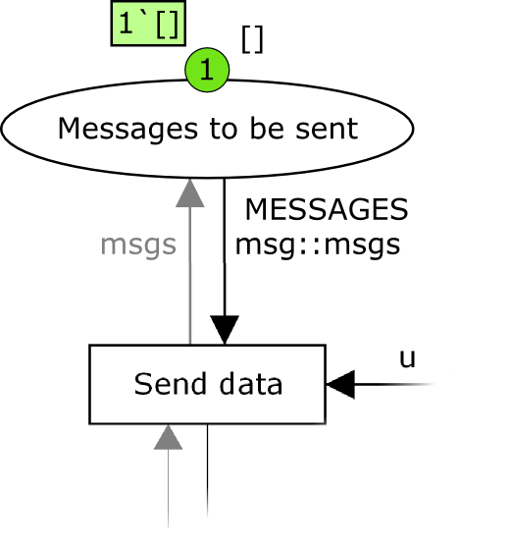
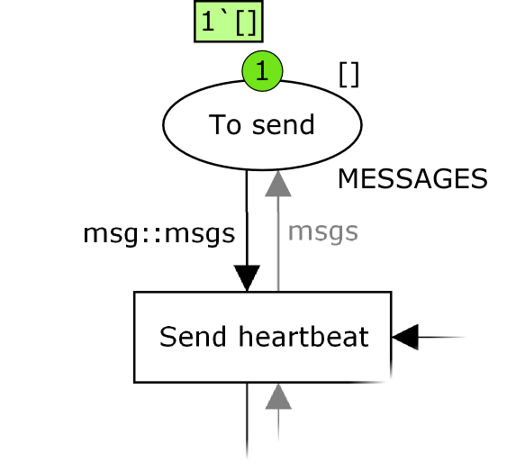
State Space Analysis
Configuration: Only establish connection, no data being sent

Slide 40
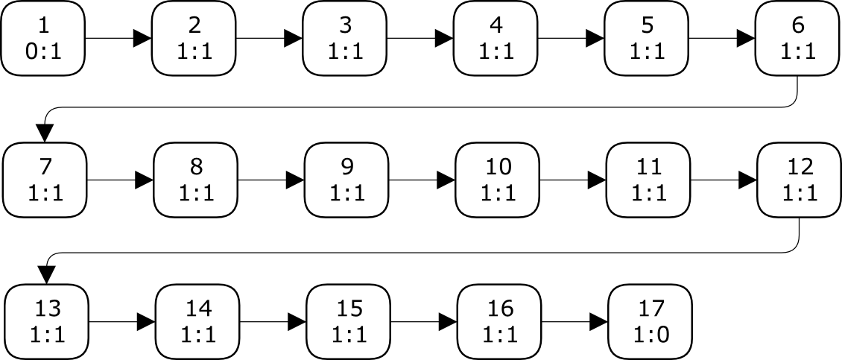
State Space Analysis
State Space
Nodes: 17
Arcs: 16
Secs: 0
Status: Full
Scc Graph
Nodes: 17
Arcs: 16
Secs: 0

Slide 41
State Space Analysis
Best Integer Bounds
Upper Lower
ClientApplication
Active_Connection 1 0
Conn_Result 1 0
Connection_failed 0 0
Messages_received 1 1
Messages_to_be_sent 0 0
[...]
Notes:
Discovered error, one place showed an upper bound of 2

Slide 42
State Space Analysis
Best Upper Multi-set Bounds
ClientApplication
Active_Connection 1`()
Conn_Result 1`success
Connection_failed empty
Messages_received 1`[]
Messages_to_be_sent empty
[...]
ClientWebSocket
Connection_status 1`CONN_OPEN
[...]
ServerWebSocket
Connection_Status 1`CONN_OPEN
[...]
Best Lower Multi-set Bounds
ClientApplication
Active_Connection empty
Conn_Result empty
Connection_failed empty
Messages_received 1`[]
Messages_to_be_sent empty
[...]
ClientWebSocket
Connection_status empty
[...]
ServerWebSocket
Connection_Status empty
[...]

Slide 43
State Space Analysis
Home Markings
[17]
Dead Markings
[17]
Dead Transition Instances
ClientApplication'Fail 1
ClientApplication'Receive_data 1
ClientApplication'Send_data 1
ClientWebSocket'Filter_messages 1
[...]
Live Transition Instances
None

Slide 44
State Space Analysis
Larger configurations
One short message
Nodes: 29, Arcs: 28
One ping, then one message
Nodes: 513 Arcs: 1141

Slide 46
State Space Analysis
One message, then one ping
Nodes: 513, Arcs: 1141
Home Markings: None
Dead Markings: [512,513]
One long message
Nodes: 813, Arcs: 2331, Secs: 2
Ping, Text, Close
Nodes: 6129, Arcs: 19625, Secs: 14
Dead Markings: 6 [6129,6112,6029,5960,5632,...]

Slide 47
State Space Analysis
One more message
Nodes: 165 748, Arcs: 707 380, Secs: 18 000 (5h)
Status: Partial
Notes:
The report also showed that it had not detected any cycles, which reinforces the claim that the model works as it should.
uncovering problems with the WebSocket CPN model, and effectively allowing us to conclude that the model is now valid
All but two of the transitions are enabled at some point; the two exceptions are Fail in the ClientApplication module and Send Reject in the ConnectionResponse module
This means we have full coverage

Slide 48
Pragma/CPN
Notes:
Name chosen to mimick other tools that work with CPN Tools, like Design/CPN, Access/CPN, and the recent Grade/CPN

Slide 49
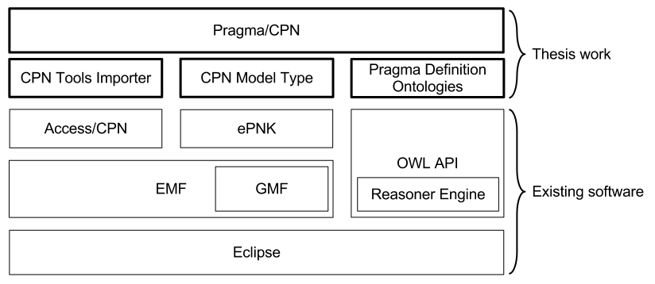
Pragma/CPN
Notes:
Everything is Open Source

Slide 50
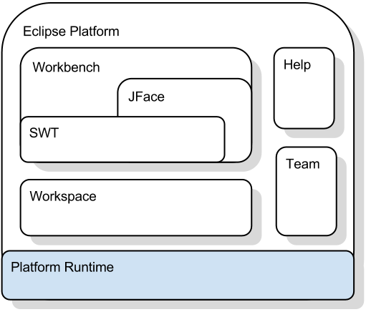
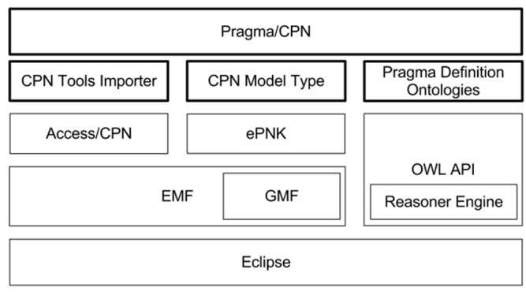
Pragma/CPN
Eclipse
dhmfng

Slide 51
Pragma/CPN
Eclipse Modeling Framework
Model driven approach to Java software development
Ecore
meta-metamodel
specialisation of MOF
Create Java implementation of model
Adapter classes for viewing and command-based editing
Simple editor
Graphical Modeling Framework (GMF)
Create graphical diagram editor

Slide 52
Pragma/CPN
Access/CPN
Java framework for working with CPN Tools models
Import and represent as EMF model instance
Use this rather than write our own importer
Other features
Not used by Pragma/CPN

Slide 53
Pragma/CPN
ePNK
Generic framework for working with standard Petri Net types
Saves models in PNML format
Tree editor and diagram editor
Supports creating custom specialised Petri Net types
Using EMF models

Slide 54
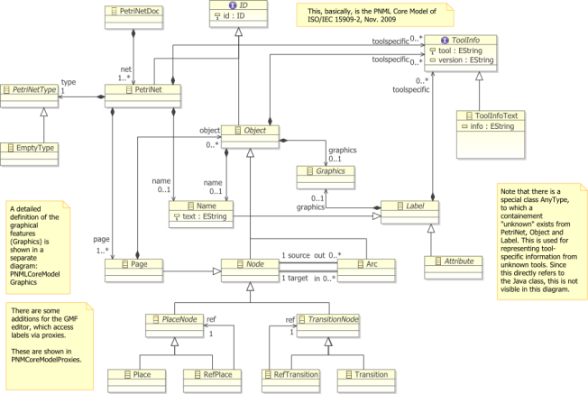
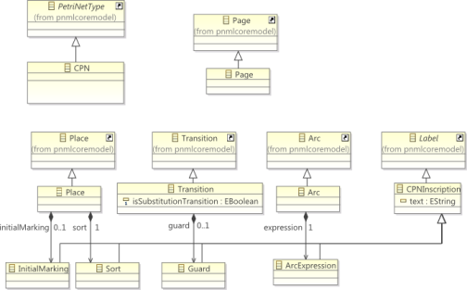
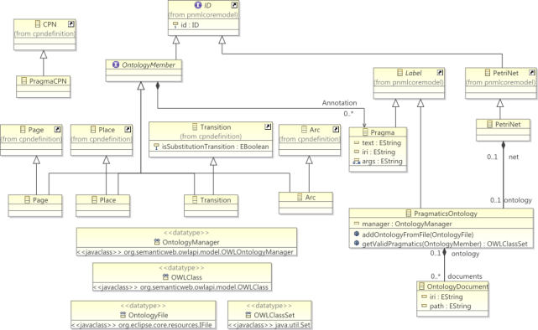
Pragma/CPN
CPN Model Type
ePNK PNML Core Model
CPN Model Type
Annotated CPN Model Type

Slide 55
Pragma/CPN
OWL API
Library for working with ontologies
Represent body of knowledge in a particular domain
Classes, properties, individuals
Axioms that define relations, restrictions
Very expressive
Different syntaxes
Reasoner engine
Deduction and entailment
Can infer implicit rules
Notes:
We decided after talking with Simonsen to represent pragmatics using ontologies

Slide 56
Pragma/CPN
Pragmatics Definition Ontology
Three base ontologies
CPN
Pragmatics and relation to CPN
Generic Pragmatics
Using reasoner engine, it deduces appropriate pragmatics for selected model elements

Slide 57
Demonstration

Slide 58
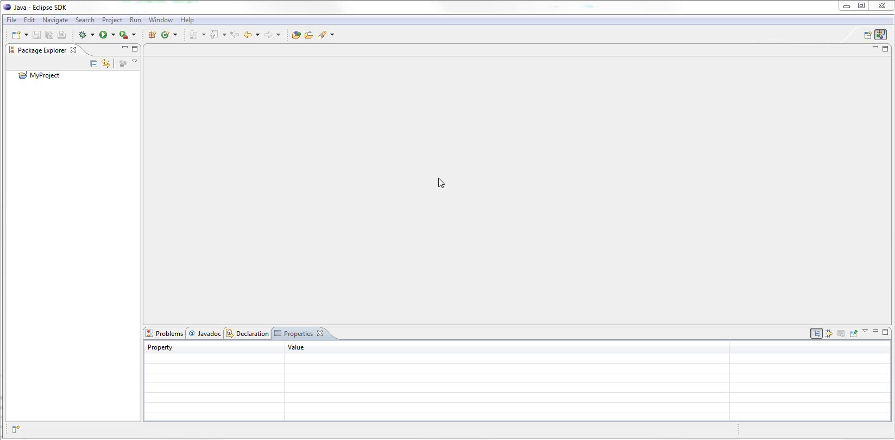
Notes:
Basic Eclipse setup
Toolbars
Package Explorer
Editor
View
Very customisable

Slide 59
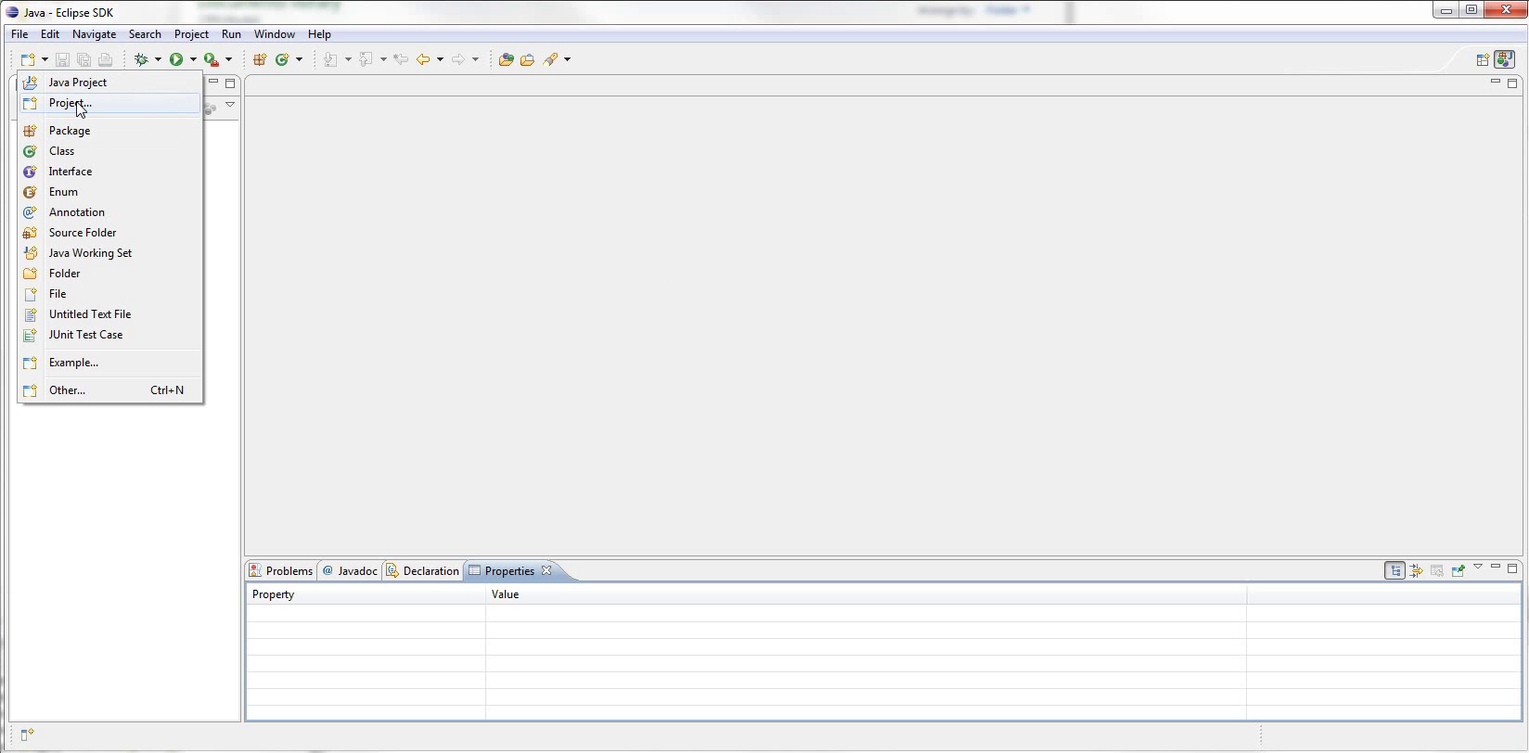
Notes:
Start with creating new project
Zoom

Slide 60
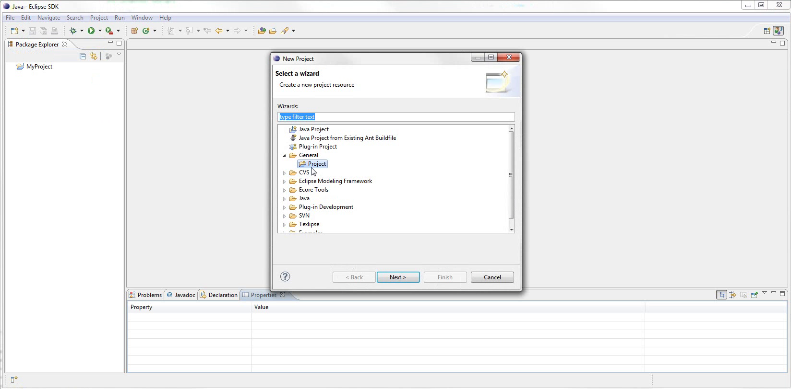
Notes:
Wizard
zoom
lets you choose several types of project
We just need general project

Slide 61
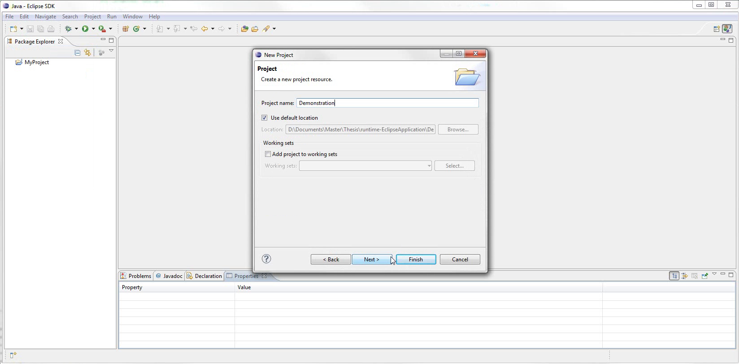
Notes:
We give the project a name
Can choose location and other settings
Hit Finish

Slide 62
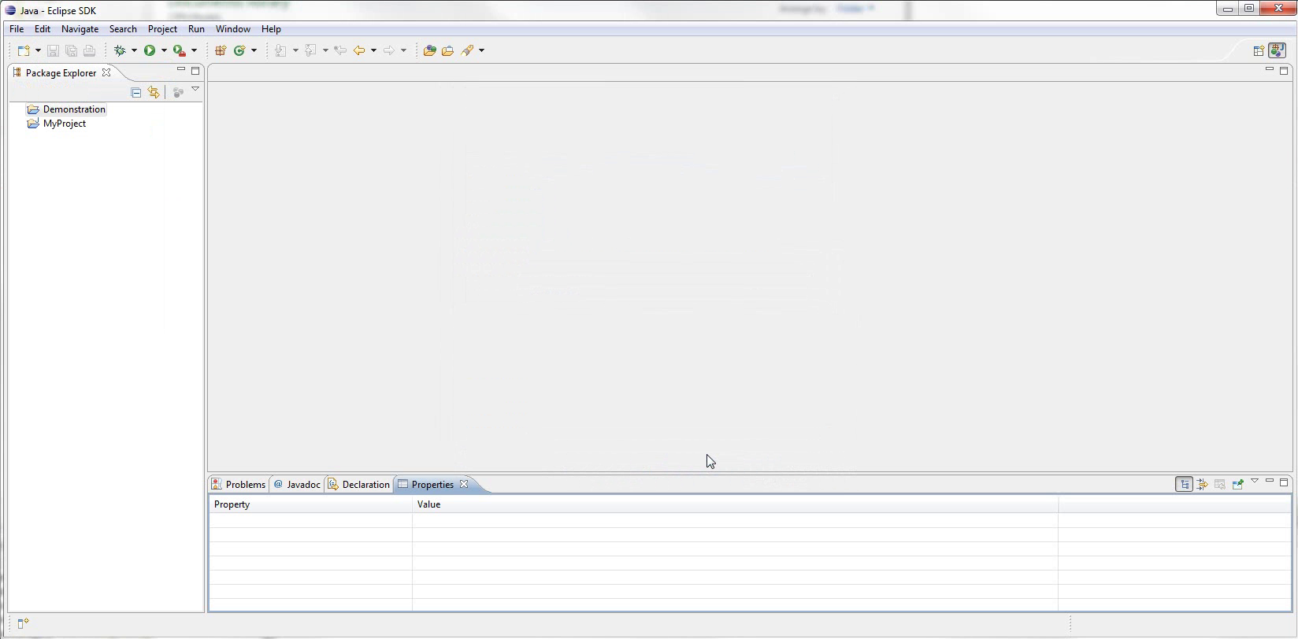
Notes:
Can see the project in explorer
We now want to import the Websocket CPN model
More than one way to run importer

Slide 63
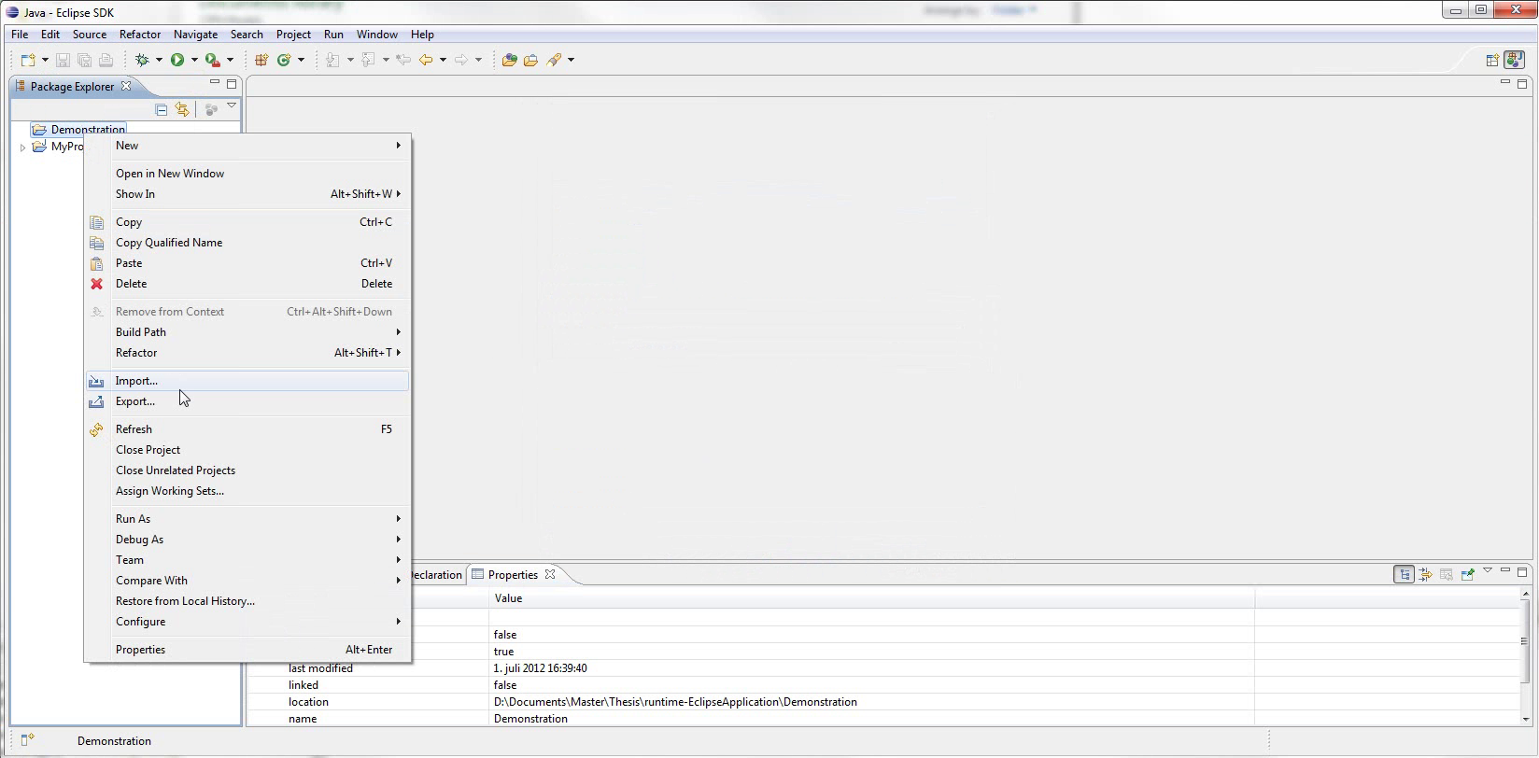
Notes:
Right click project and select import

Slide 64
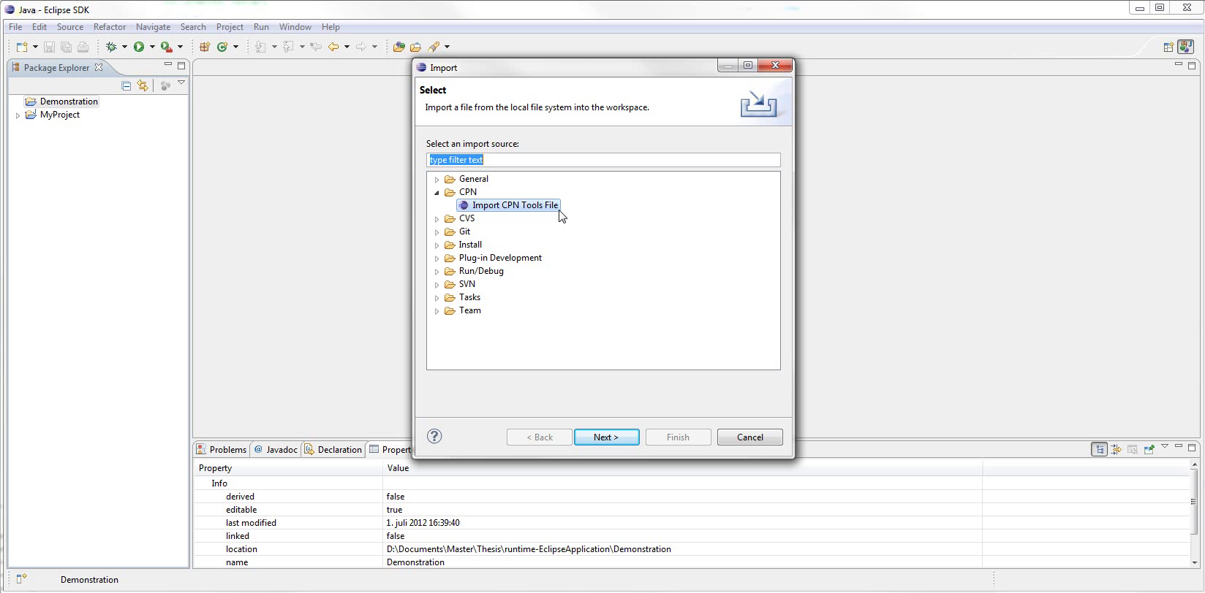
Notes:
This is Import dialog
Zoom
Can select from many available importers

Slide 65
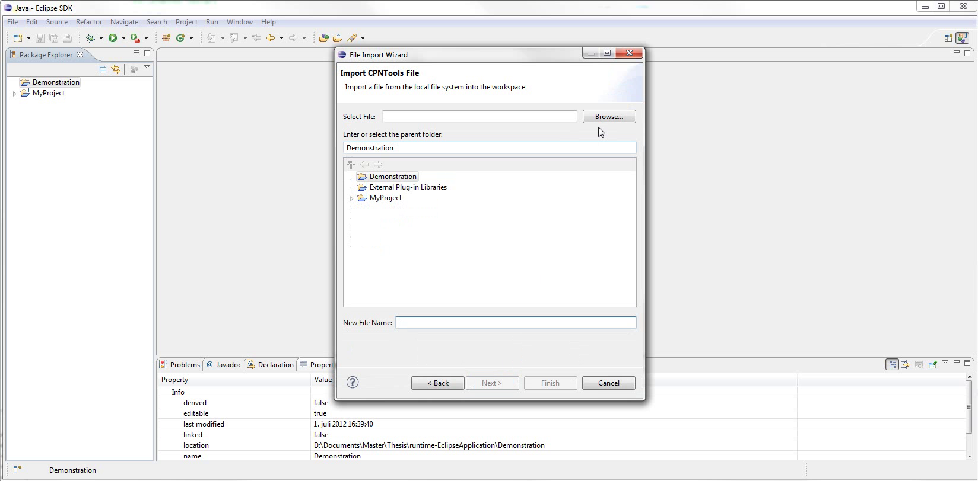
Notes:
This is the CPN importer
Need two things:
Select the cpn file to import
Select where to put the imported model
So we hit Browse...

Slide 66
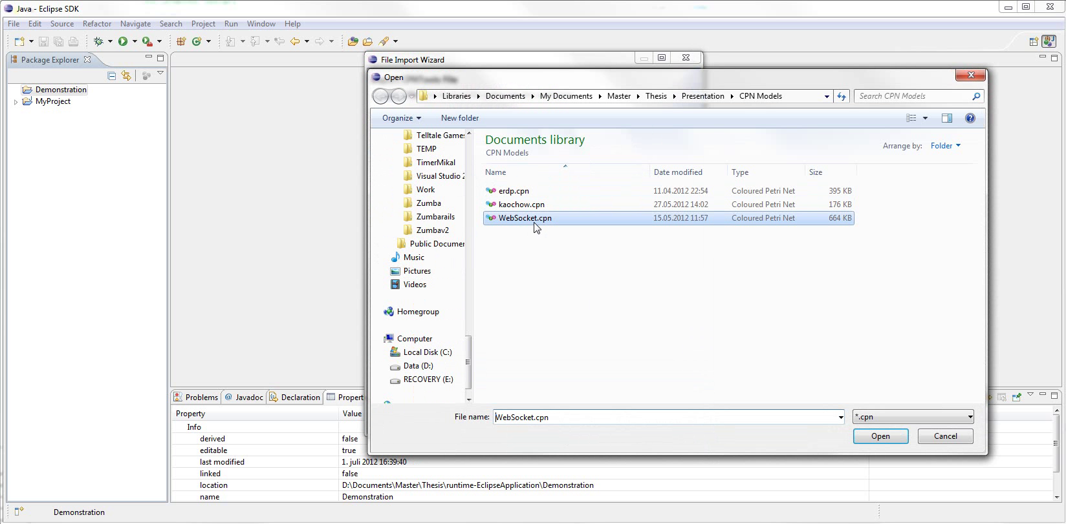
Notes:
Select the cpn file

Slide 67
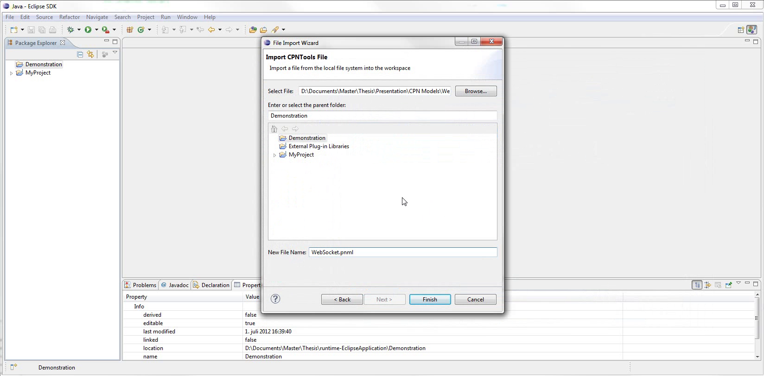
Notes:
Demonstration project already selected
File name suggested (new extension)

Slide 68
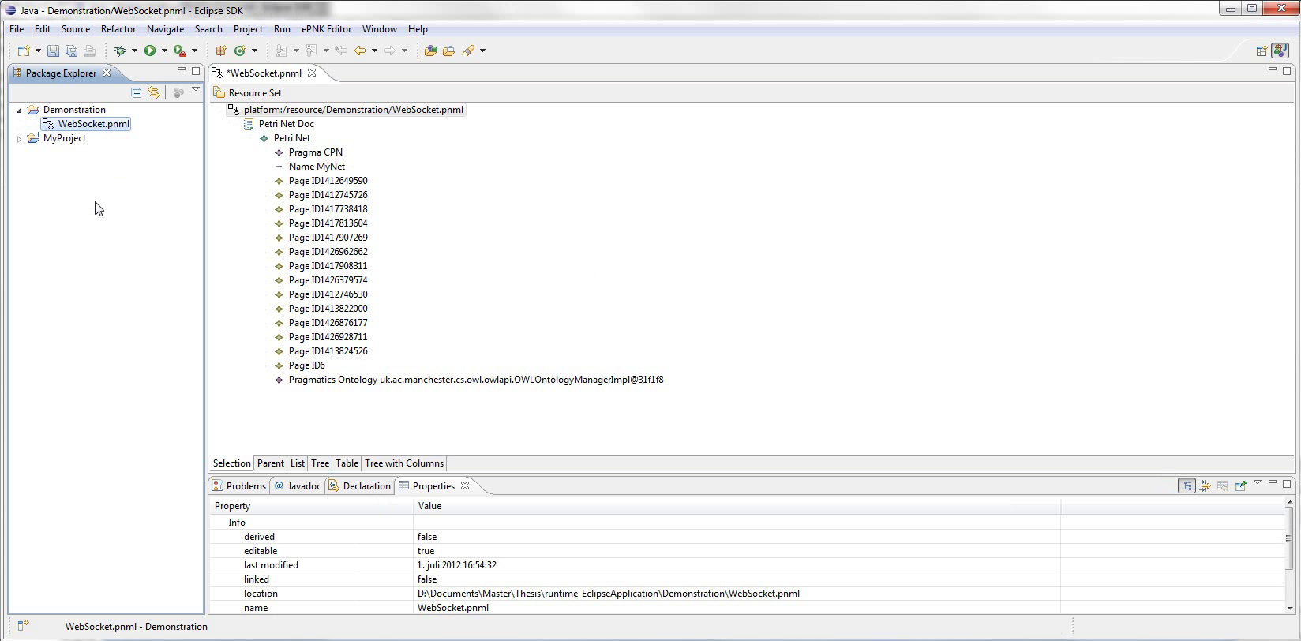
Notes:
Here is result
Note file contained in project
Model elements labeled by ID
Also have a Pragmatics Ontology instance

Slide 69
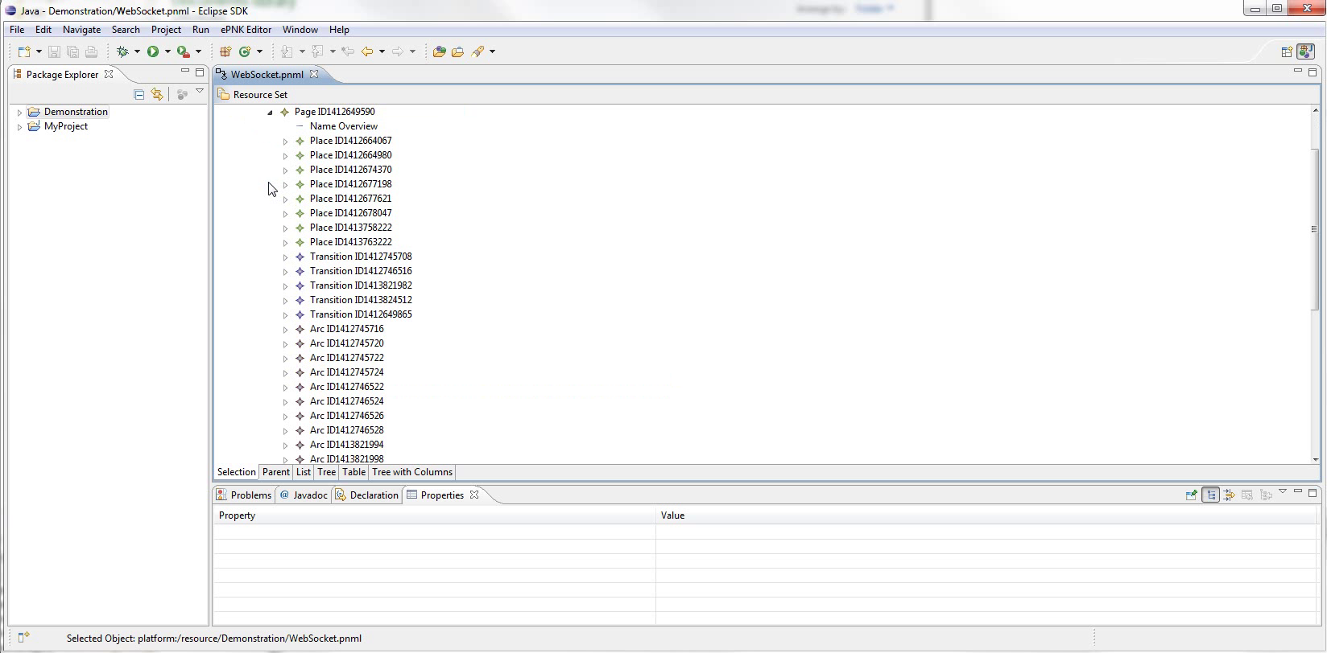
Notes:
Here is the child elements of the Overview page

Slide 70
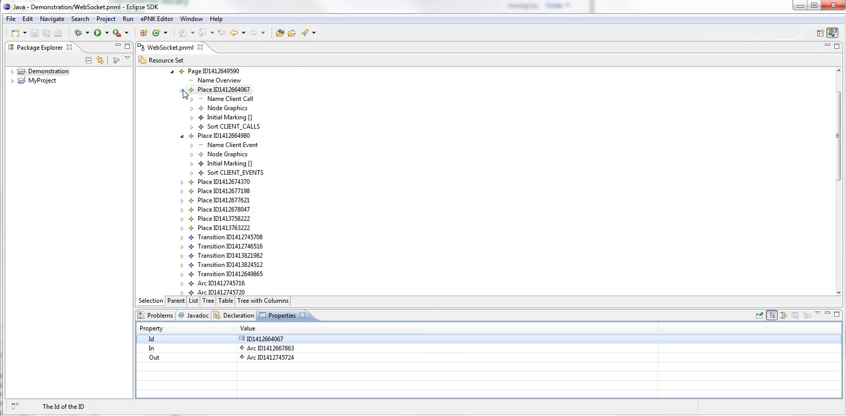
Notes:
A few places expanded to show their child elements
Reasons for this
Note properties view at bottom

Slide 71
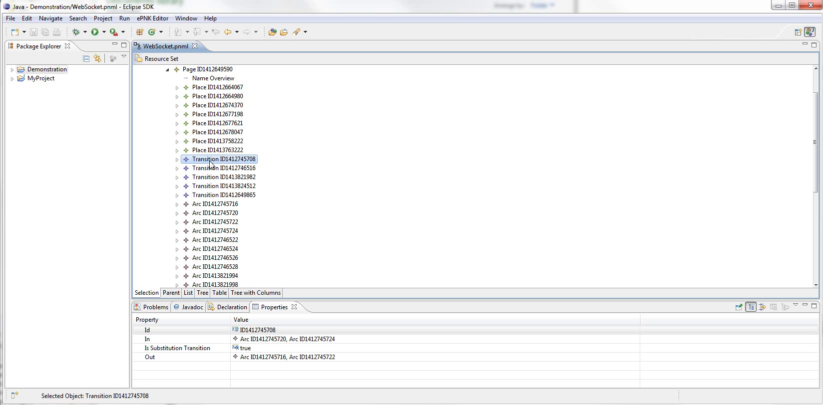
Notes:
Different for each element
Zoom for details

Slide 72
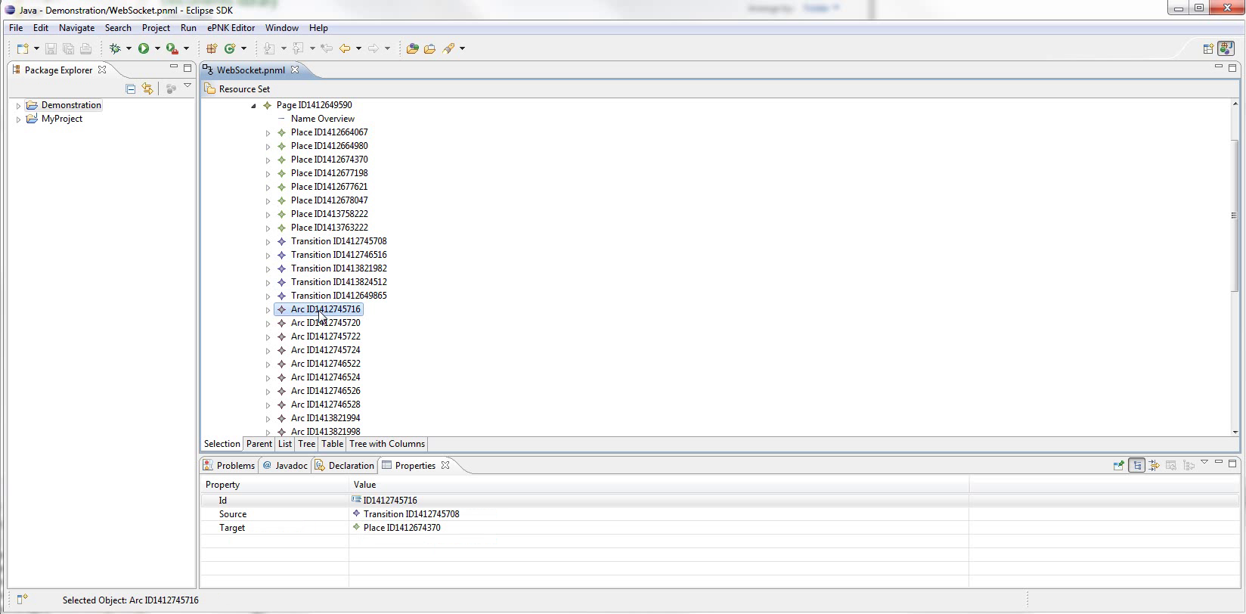
Notes:
A bit difficult to visualise
So by double clicking a page, we can open the diagram editor

Slide 73
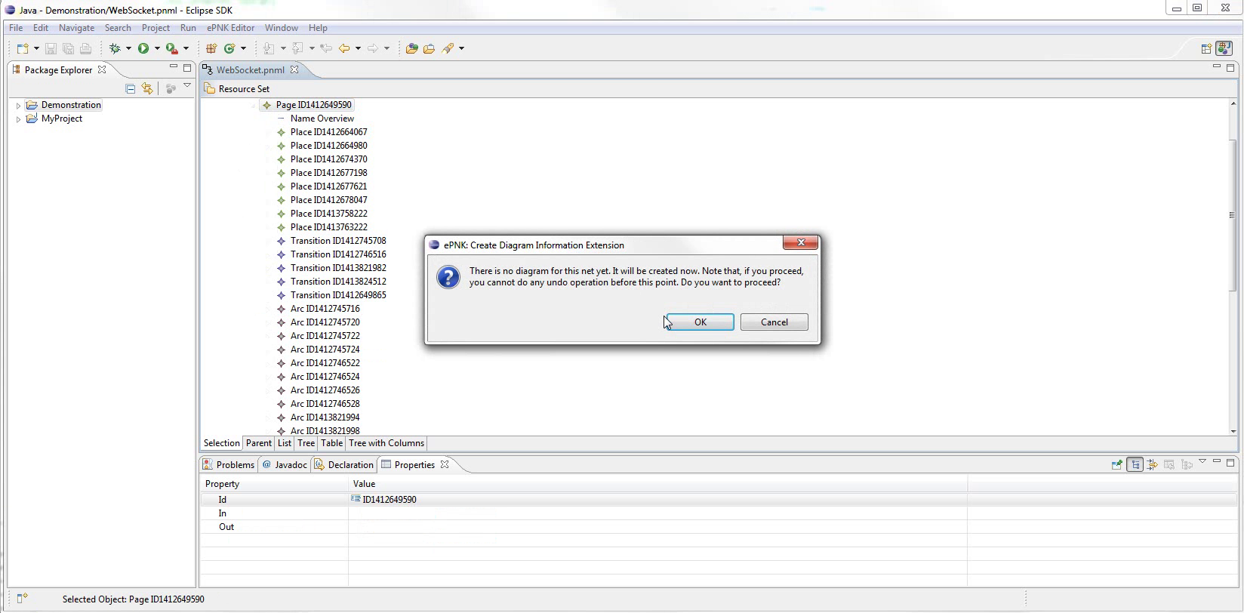
Notes:
zoom
It will ask to generate some extra data for the model

Slide 74
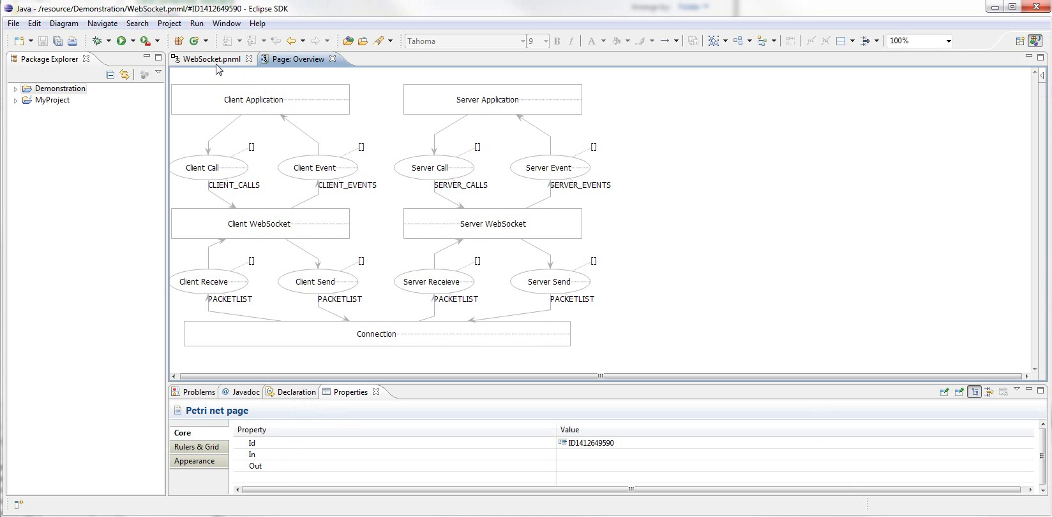
Notes:
Here it is.
Layout isn’t perfectly mirrored from CPN Tools, but everything can be manually adjusted.
Eclipse is very customisable, so we can...

Slide 75
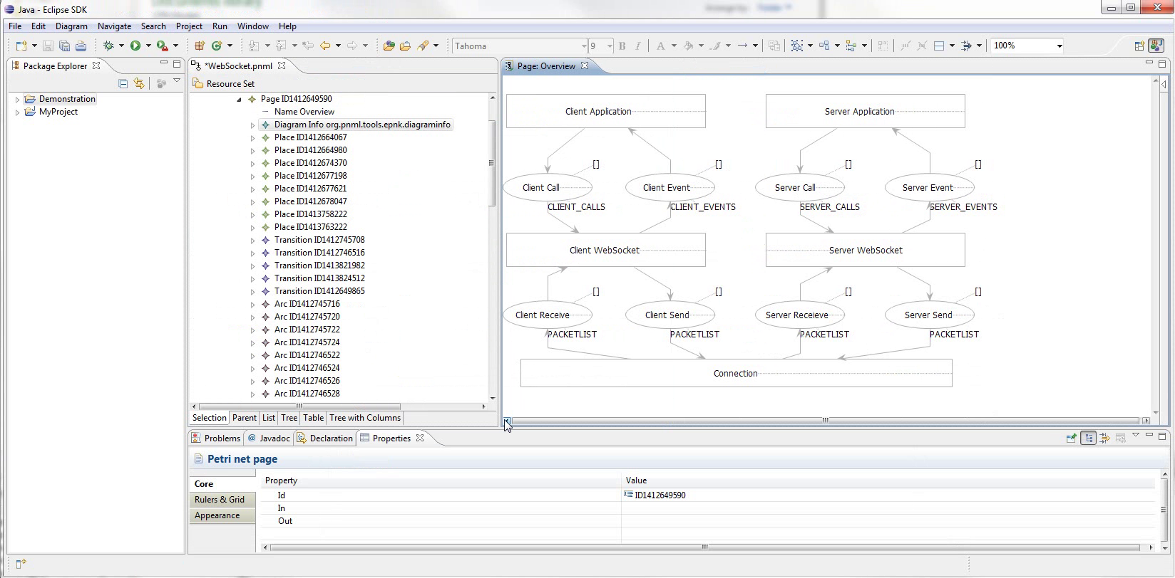
Notes:
... Show both editors at once.
Unfortunately not synchronised

Slide 76
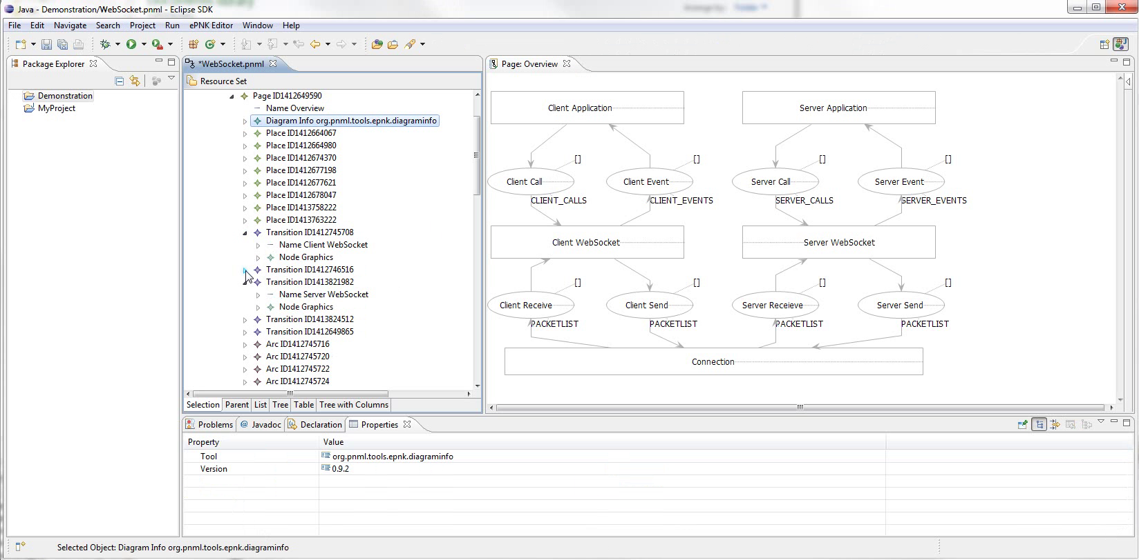
Notes:
Using editors together, we locate the model elements we want to annotate
First, annotate Principals

Slide 77
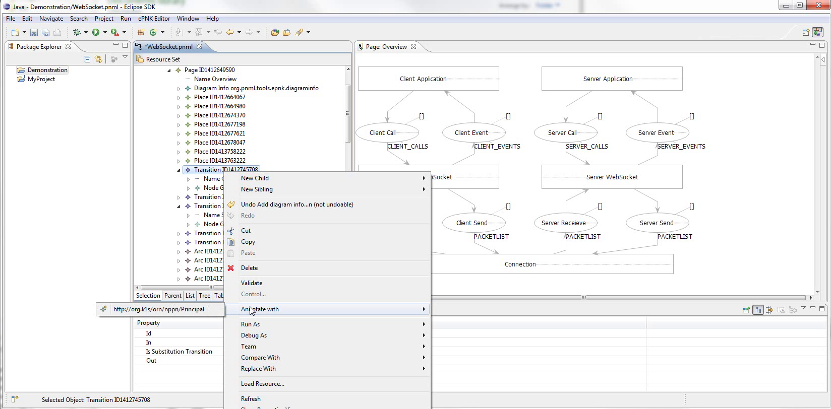
Notes:
Right click the element, show Annotate With submenu,
Zoom
shows only applicable pragmatics.

Slide 78
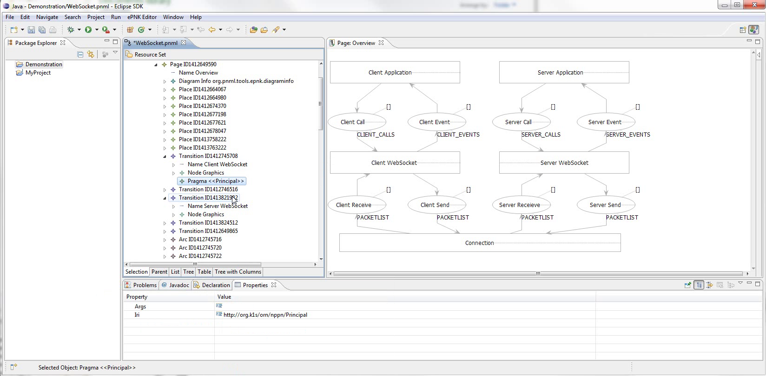
Notes:
Here the element is annotated.

Slide 79
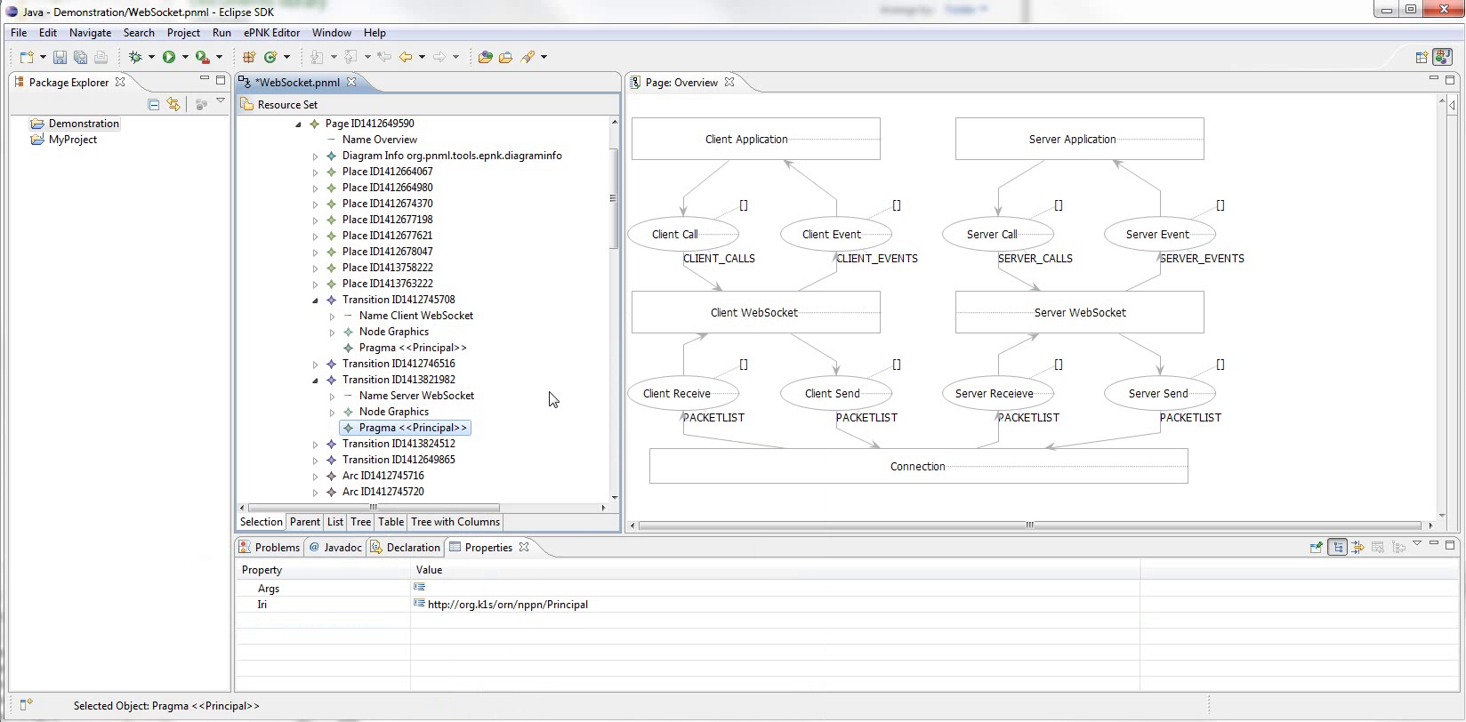
Notes:
And the other one as well.
Next, annotate channels

Slide 80
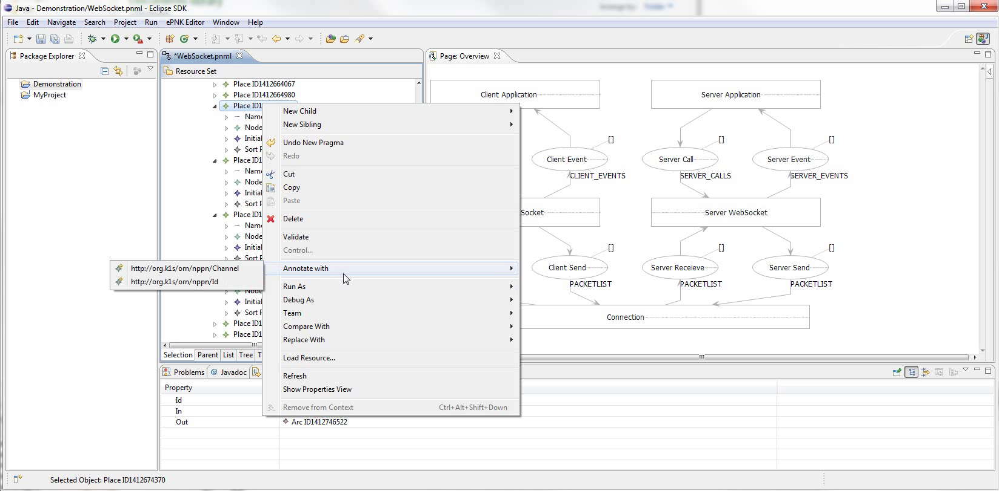
Notes:
Here we see the menu for a Place
Zoom
Emphasise that these are not exhaustive

Slide 81
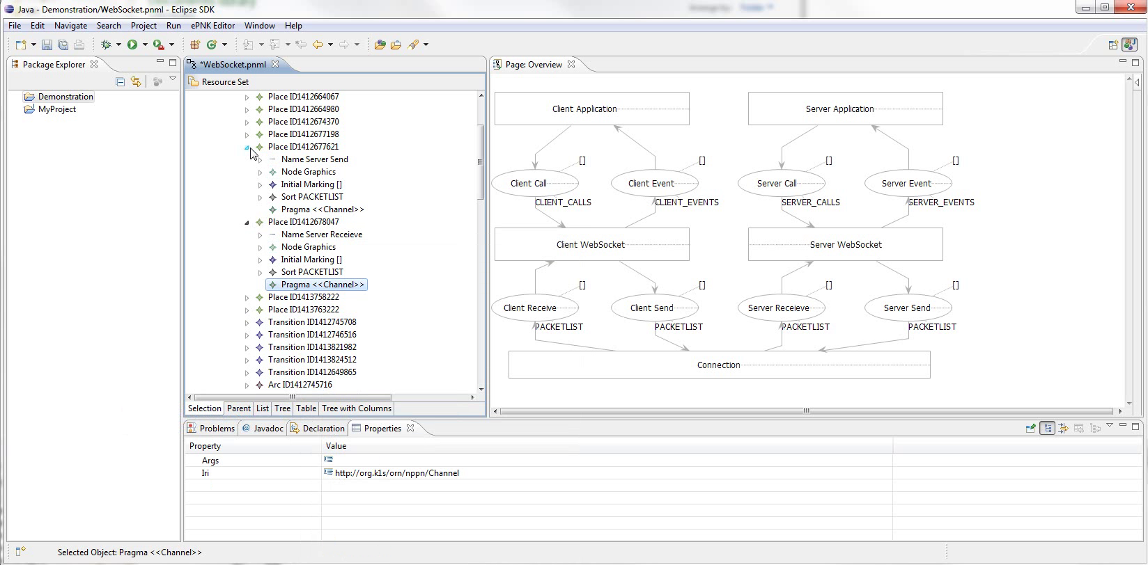
Notes:
Skip a little, And here the elements have all been annotated.

Slide 82
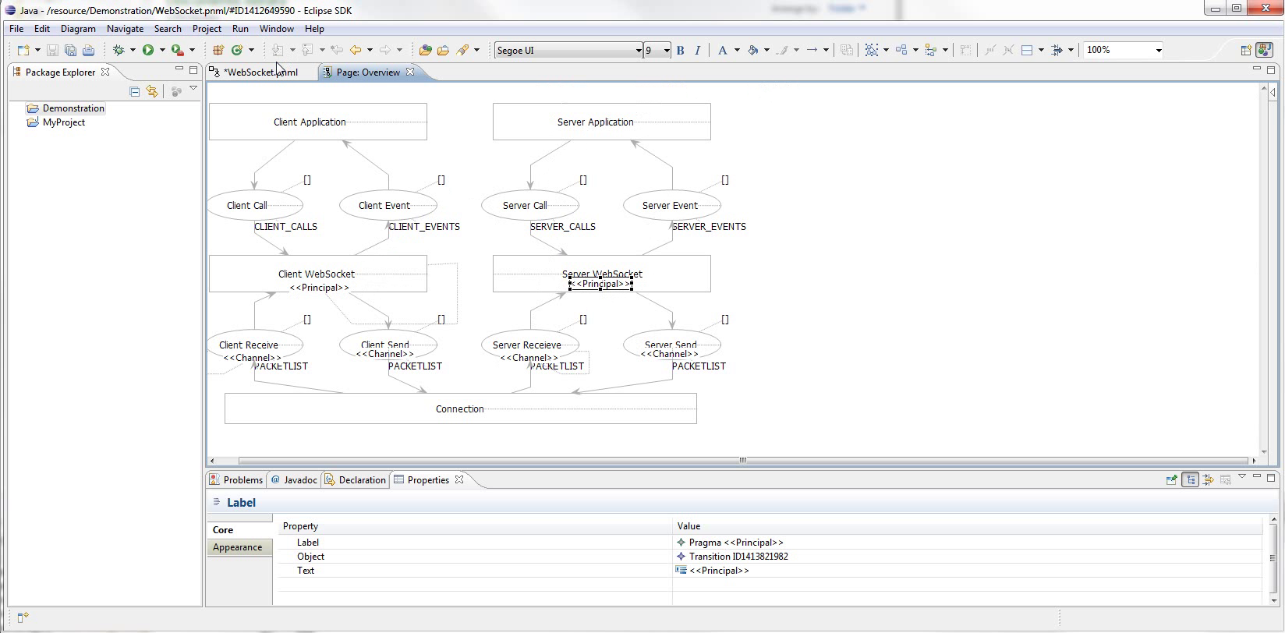
Notes:
To show this in the diagram editor, we need to close and reopen it.
New pragmatics will not automatically be properly positioned, but can be manually moved.
Zoom

Slide 83
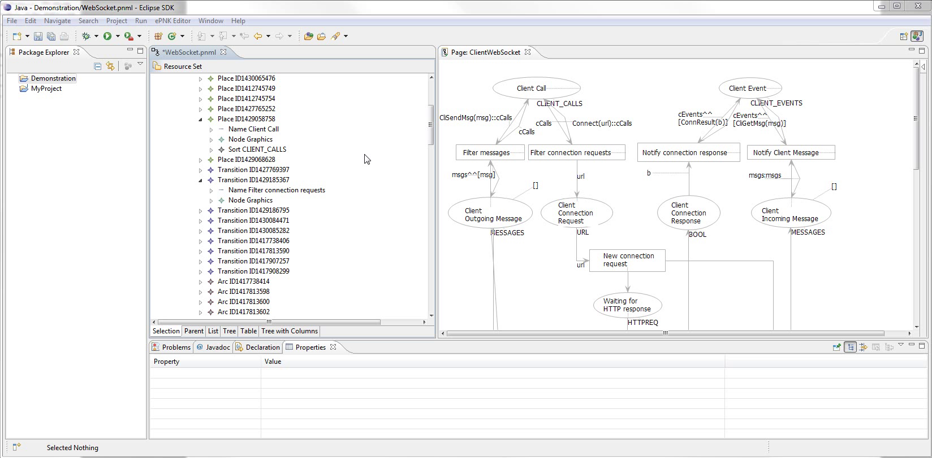
Notes:
Next up is the ID and External Pragmatics
Remember idea for them
So for example, one if the client calls is a connection request.
Zoom
Starts at transition Filter Connection Requests
But it needs to be connected by an incoming arc to a place annotated with Id

Slide 84
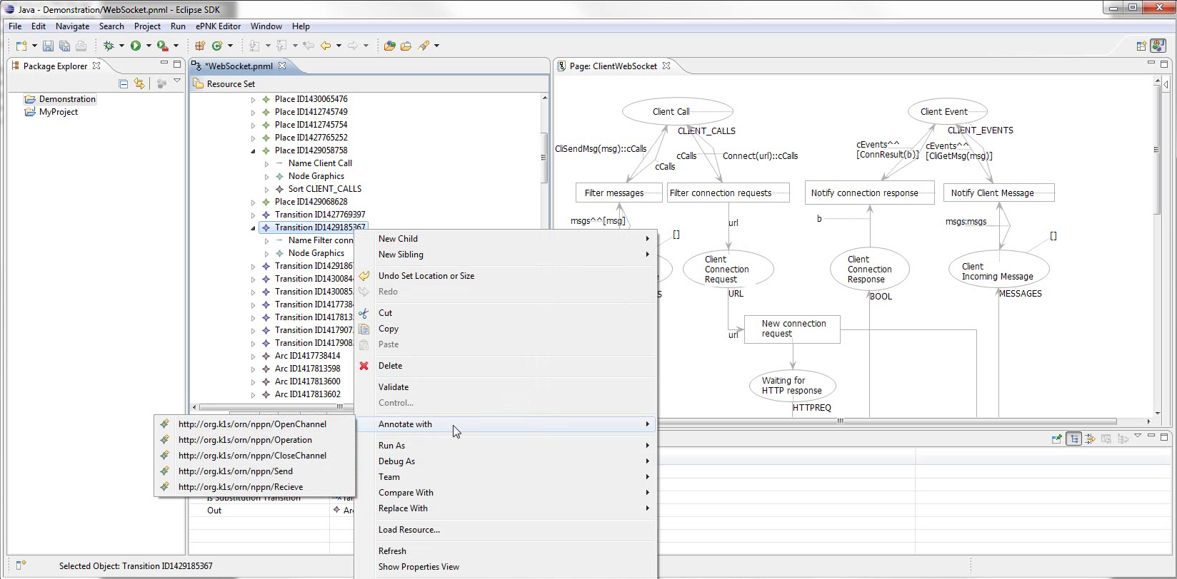
Notes:
If we try to annotate it,
Zoom
External isn’t available.

Slide 85
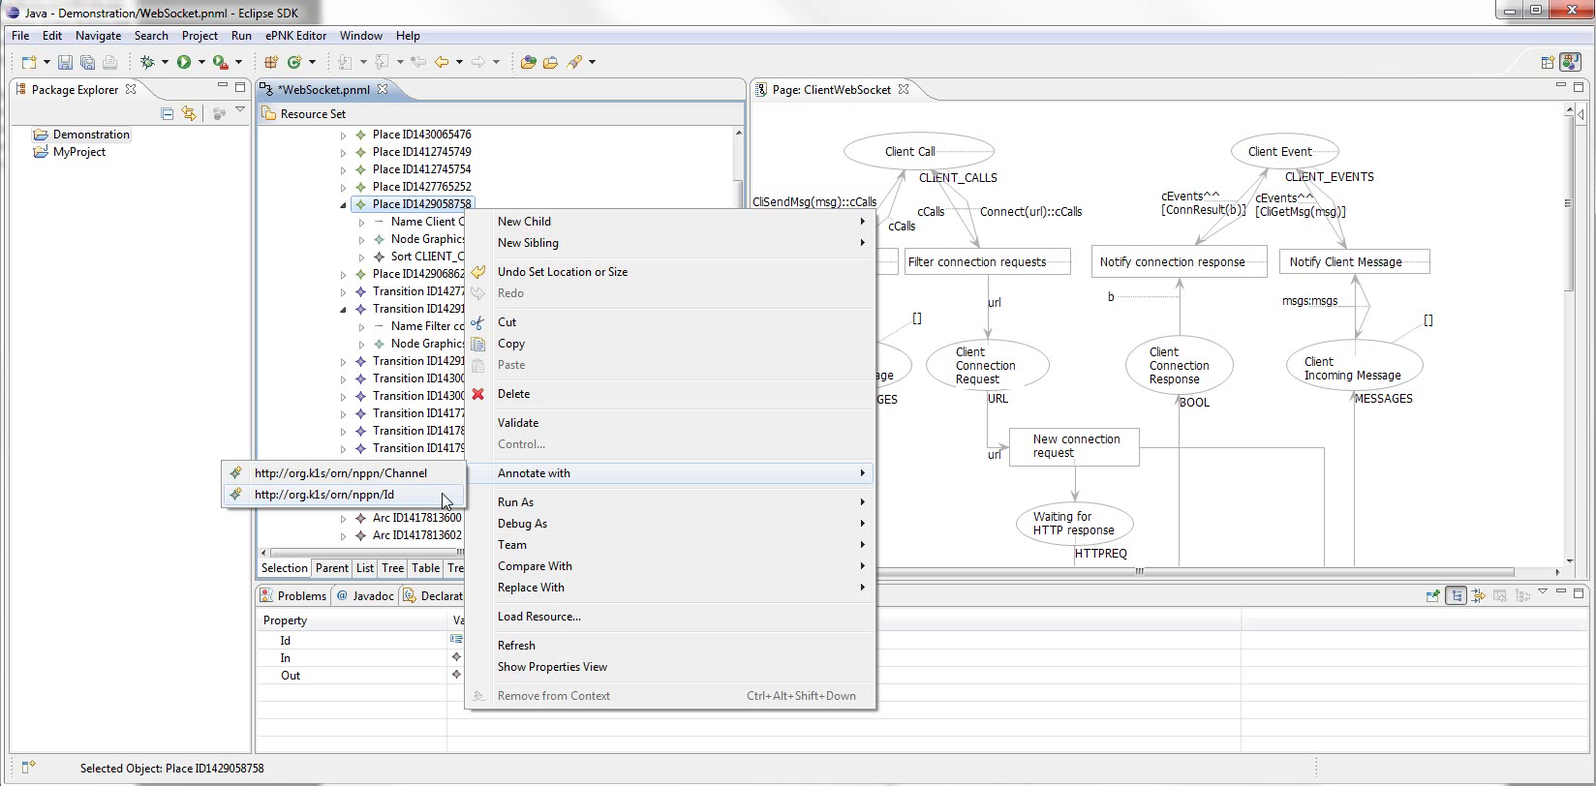
Notes:
However, if we first annotate Client Call with Id...

Slide 86
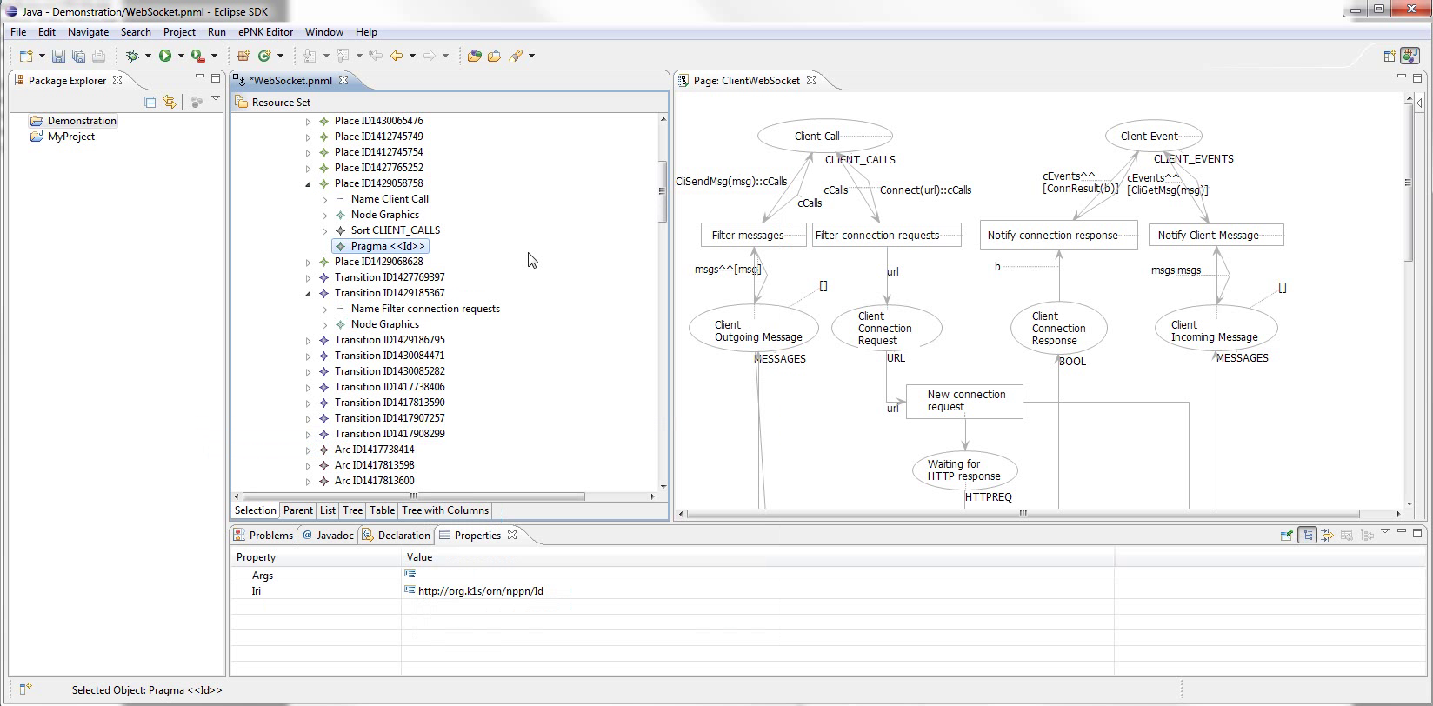
Notes:
Like so...

Slide 87
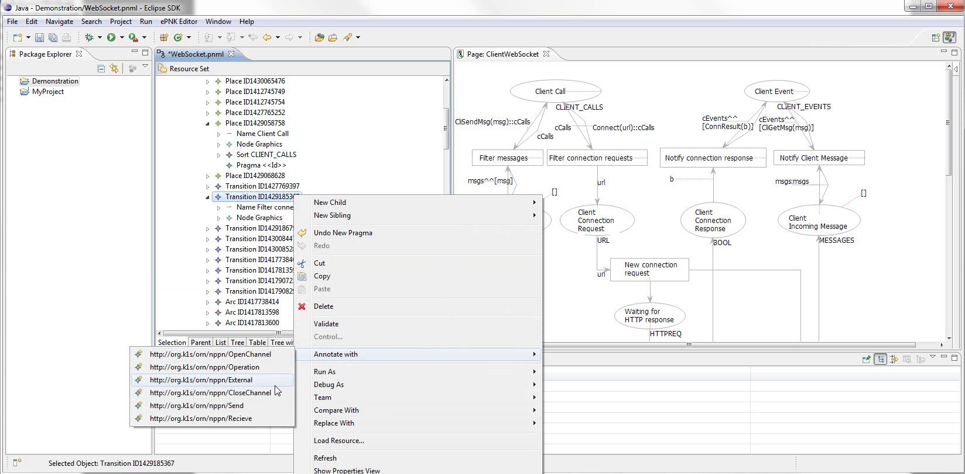
Notes:
Zoom
We now have External as an option for the transition

Slide 88
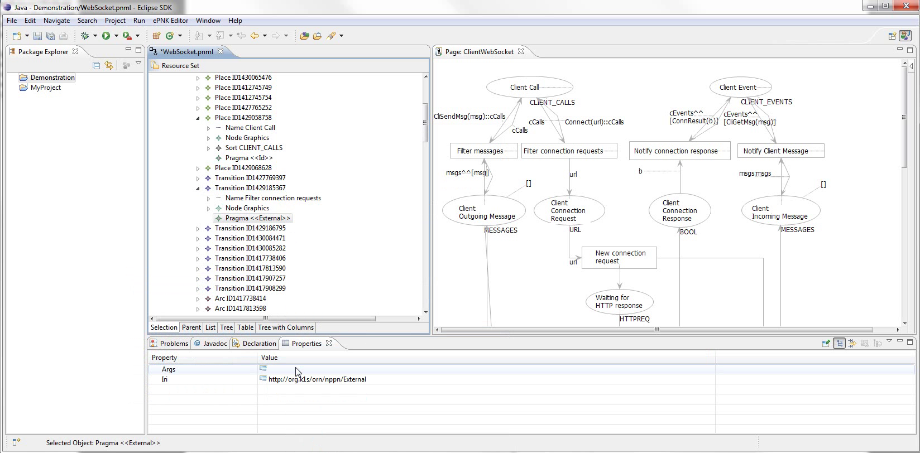
Notes:
Good time to demonstrate pragmatics arguments
zoom
Note that a pragmatic has a property args.
In the case of External, it signifies actual arguments for the external method.
If we click to edit it...

Slide 89
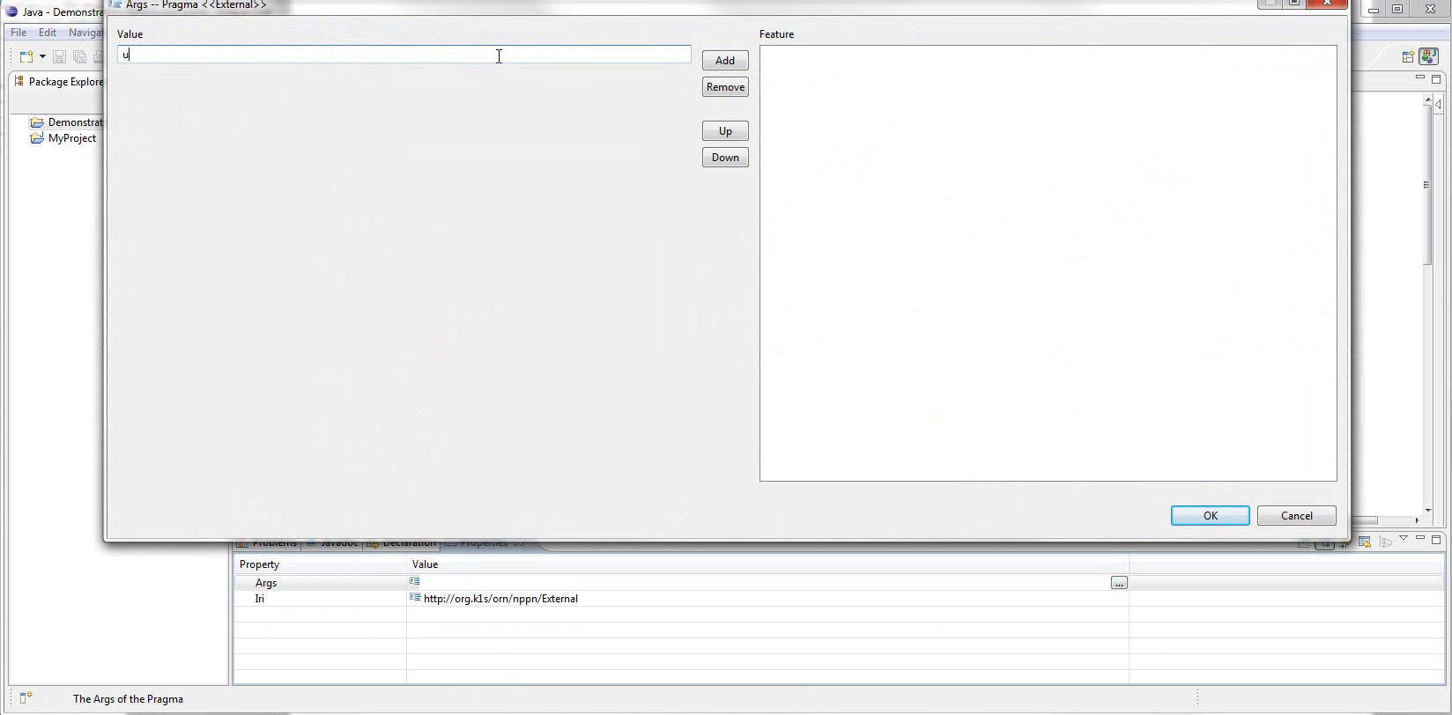
Notes:
We’re given a generic editor
Args is defined as a list of strings, so the editor lets us add and remove strings

Slide 90
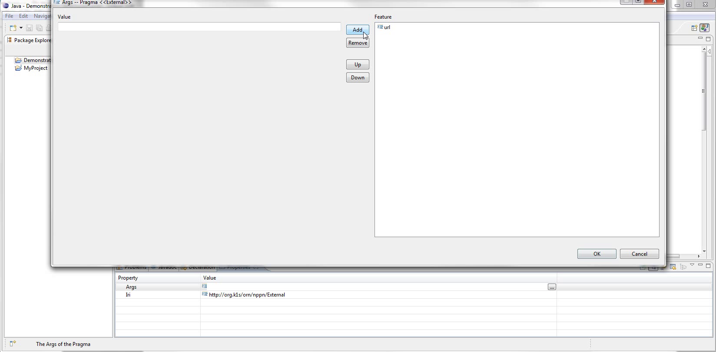
Notes:
We add the argument «url»

Slide 91
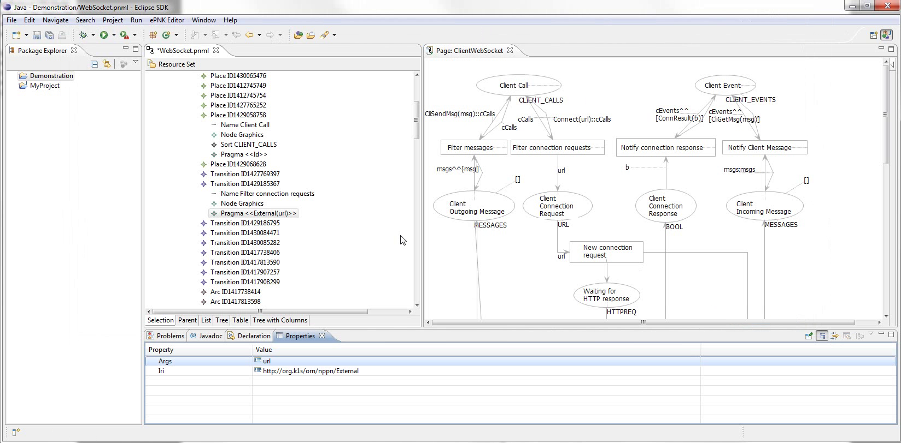
Notes:
And it’s now displayed in the pragmatic label

Slide 92
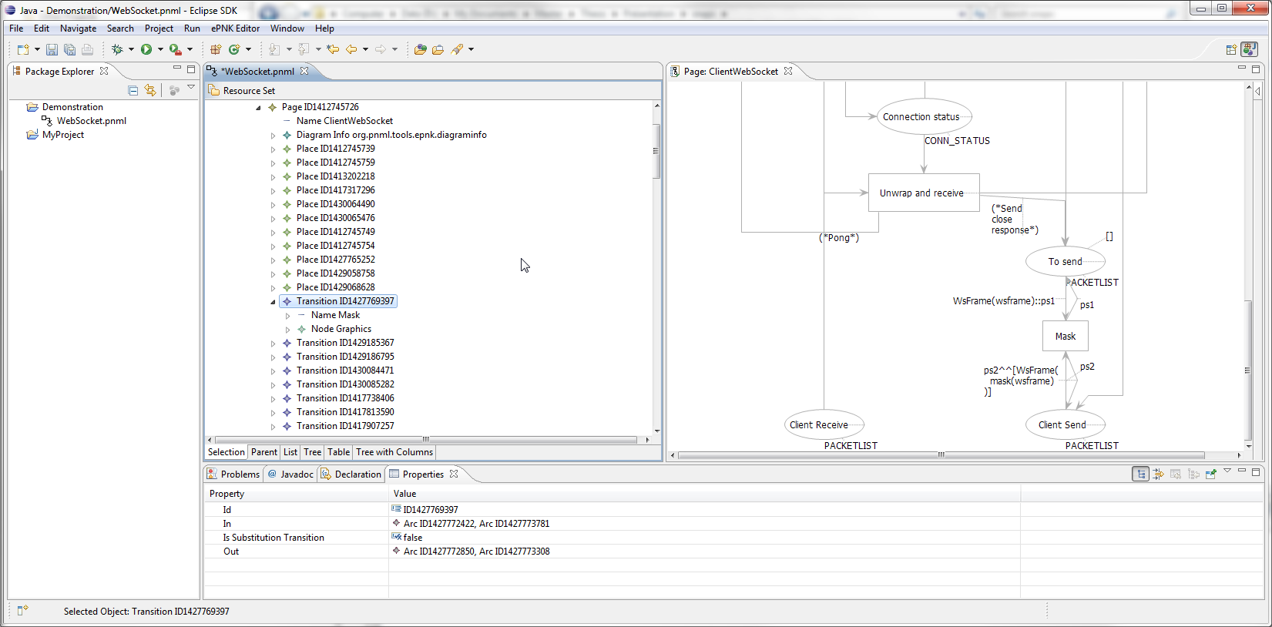
Notes:
Finally, show model specific pragmatics.
Suppose we want or need to handle masking specially
Showing the Mask transition
Let’s make a specific pragmatic for it

Slide 93
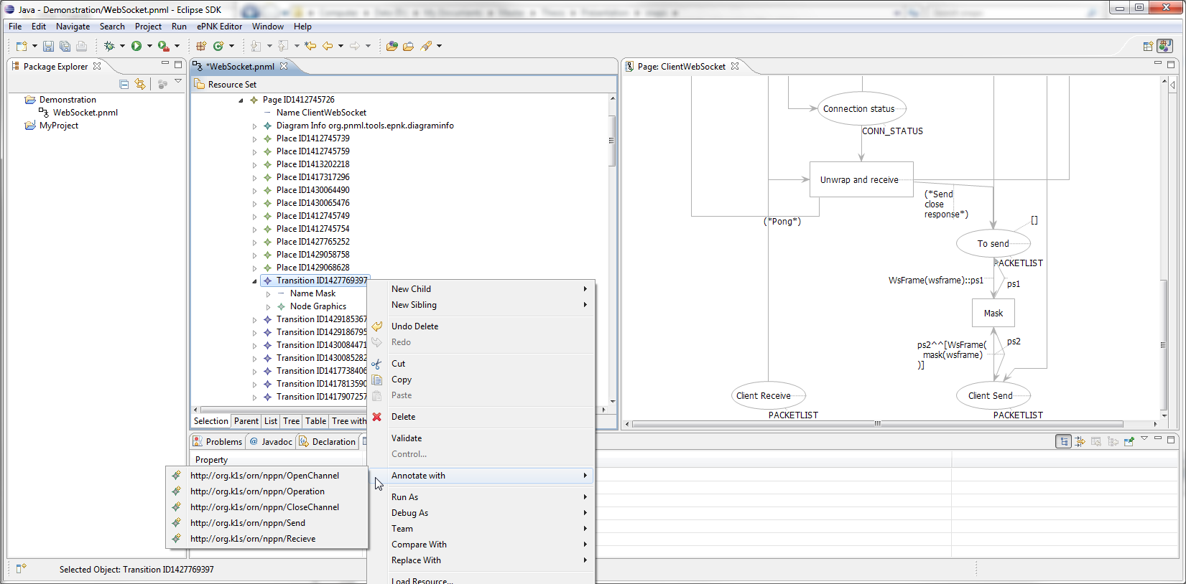
Notes:
Just to make sure, here’s the usual list for a transition

Slide 94
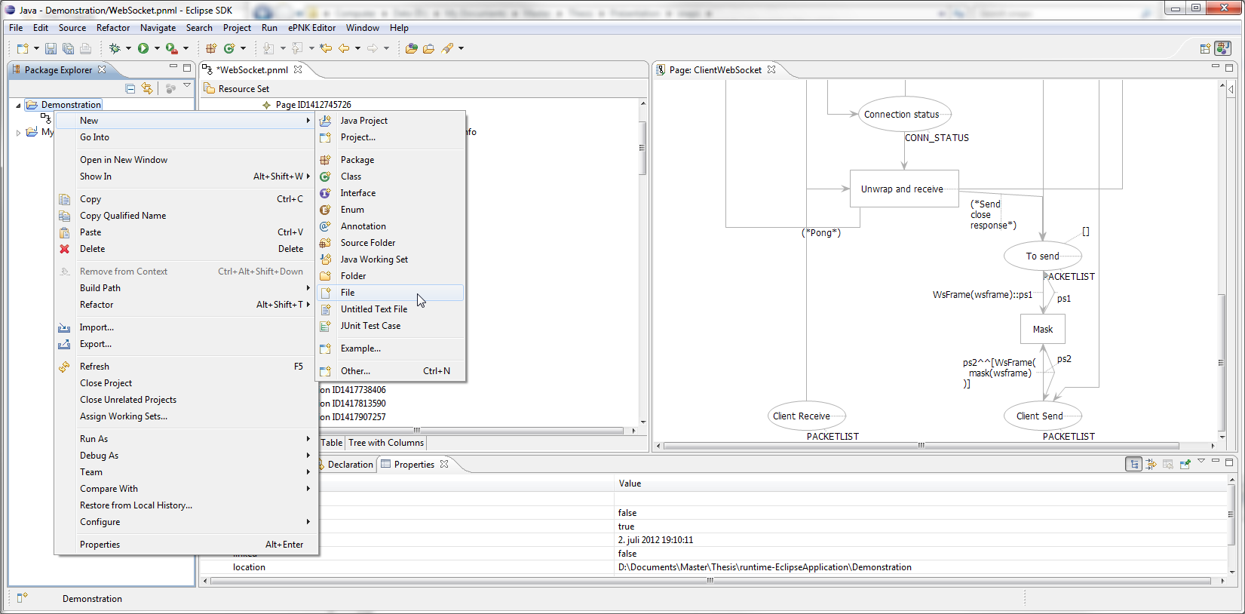
Notes:
We need to write an ontology for the pragmatic, so we create a new blank file.
Again, several ways
We right-click project, new, file

Slide 95

Notes:
Name it mask.fowl
Zoom

Slide 96

Notes:
The extension makes Eclipse automatically load an appropriate editor for the new file.
Simonsen has provided a basic editor with a few content assist features
If we activate it with ctrl space

Slide 97

Notes:
We are given a list of suggestions that can be inserted
Zoom
The first one actually is a block of text containing default imports for pragmatics ontologies

Slide 98

Notes:
Here is the result of selecting it

Slide 99

Notes:
We write our axioms, simply defining the classes Mask and Unmask, and restrict that both must belong to transition.
Save the file and close it.

Slide 100

Notes:
Back in the model, find Pragmatics Ontology at the bottom
Right click it

Slide 101

Notes:
Select pragmatics
Zoom
Add ontology

Slide 102

Notes:
File selector for all files in containing project
Not filtered for extensions currently, as not all ontology editors use correct extensions, and OWL API only looks at file contens
Same method used to add domain specific pragmatics
Could be extended to add ontology documents available online as well.

Slide 103

Notes:
Here we see (zoom) the ontology as a child element
Will be persisted and loaded (provided file still exists)

Slide 104

Notes:
And if we try to annotate the transition now

Slide 105

Notes:
zoom
Mask and Unmask is available

Slide 106

Notes:
Here the pragmatichas been placed.

Slide 107
Evaluation

Slide 108
Prototype Evaluation
All requrements met
Importing CPN Tools models.
Annotate model with pragmatics.
Loading sets of domain-specific pragmatics
Define set(s) of model-specific pragmatics
Proof of concept for Simonsen’s ideas

Slide 109
Performance
Time to determine approprite pragmatics too long
25 elements: ~1 second delay
Kao-Chow – 96 elements: ~7 seconds
WebSocket – 372 elements: Minutes...
Cause: Ontology Closed World Reasoning
Workaround: Only consider elements on single page
Better solution: Changes to reasoner engine

Slide 110
Thesis Evaluation
Example of applied Model Driven Engineering
Working prototype
Needs refinement
Evaluation chapter too short
Have not extensively shown the potential of ontologies for defining pragmatics

